Slide 1
Operating Systems BSHC1
Introduction
Dr. Cristina Muntean
Cristina.Muntean@ncirl.ie

Slide 2
Module Information (BSHC1 and BSHBIS1)
Contact hours:
2 hours lecture : Monday 11 am to 1 pm (SRC3)
1 hour lab: Tuesday 11 am -12 pm (HLAB303)
Assessment:
50% Continuous Assessment.
35% CA Test (Week 9 – Monday, 23rd of March, 2015 )
15% - one short in-class quiz (Week 4 – Lab session)
lab exercises from each week will reinforce the week’s topic and may involve practicing on UNIX type OS machines
50% Exam.

Slide 3
Syllabus
Introduction into OS
History, OS’s structure, Windows and Unix
User Interface
OS Architecture (Windows and Unix)
Resource Allocation and Scheduling
Deadlock, Scheduling Algorithms,
File System
Exemplification on Windows and Unix
Security and Protection
Input and Output operations
Memory Management
Revision class

Slide 4
Reading Books
Essential Reading
Stallings, W. (2011) Operating Systems Internals and Design Principles, 7th Edition, Prentice-Hall
Colin Ritchie (2003): Operating Systems Incorporating Unix and Windows, 4th Edition, Letts Educational
Hocombe 2005): Survey of Operating Systems, Mc GrawHill
Recommended Reading
Silberschatz, Galvin and Gagne (2012) Operating System Concepts, 9th Edition, John Wiley & Sons Inc
Lister, A.M and Eager, R.D. (1993) Fundamentals of Operating Systems, Macmillan
Nutt, G. J. (2003) Operating Systems: A Modern perspective, 3rd Edition, Addison Wesley.

Slide 5
Topics covered in this lecture
What is an Operating System (OS)?
Characteristics of typical Operating System
Responsibilities of a Operating System
Brief background and history of OSs
Windows and Unix
Brief introduction about Windows NT and Unix
History
Main characteristics
The structure of a typical Operating System

Slide 6
1.1 What is an Operating System?
Computer =
Computer
Software
Computer
Hardware
+
Computer
Software
=
System
Software
+
Application
Software

Slide 7
1.1 What is an Operating System?
Computer Hardware
a comprehensive term for all of the physical parts of a computer
Example: CPU, mouse, hard drive, printer, monitor, memory, etc.

Slide 8
1.1 What is an Operating System?
Computer Hardware
System Software
Provides a general programming environment in which programmers can create specific applications to suit their needs
It acts as an interface between the hardware of the computer and the application software that users need to run on the computer.

Slide 9
1.1 What is an Operating System?
Computer Hardware
System Software
Application Software
Consists of a collection of programs used by various uses for performing different tasks.
Examples: spreadsheets, database systems, desktop publishing systems, program development software, and games.
This software is designed to solve a particular problem for users

Slide 10
1.1 What is an Operating System?
The most important part of System Software is the Operating System
Operating System = Software program that manages all
the available hardware resources on
a computer
An Operating System acts as an intermediary/interface between a user of a computer and the computer hardware

Slide 11
1.2 Operating System’s responsibilities
Operating System has three main responsibilities:
1) Perform basic tasks such as
recognizing input from the keyboard
sending output to the display screen,
keeping track of files and directories on the disk,
controlling peripheral devices (e.g. disk drives and printers)
2) Ensure that different programs and users running at the same time do not interfere with each other.
3) Provide a software platform on top of which other programs (i.e. application software) can run

Slide 12
1.3 Characteristics of a typical OS
Operating System must support the following
Concurrency
Activation of several processes (apps.) at the same time
Sharing
Resources should be shared between running processes
Non-shareable (e.g. printer) and shareable resources (e.g.read only files)
Long term storage
Data is not lost after turning off the computer
Also desirable to provide the following:
Efficiency
Reliability
Maintainability
Small size

Slide 13
1.4 Operating Systems - Brief History
The first generation of computers (1945 – 1955)
Had no operating systems
Only one program was run on the computer at a time.
The programmers would load manually the program they had written (on punched cards) and run it.
Very few computer, many other people waiting for their turn to run their program = > may wait several days to run your program!

Slide 14
1.4 Operating Systems - Brief History
The second generation of computers (1955 – 1965)
Mainframe era
Big machines (called mainframes) were locked away in specially air conditioned computer rooms, with staffs of professional operators to run them.
Very expensive machines with a multimillion dollar price tag
As technology advanced => many programs were all loaded onto a single tape using a small computer.
This tape was then loaded on the mainframe machine and manipulated by program called logically monitor
The logically monitor monitors the behaviour of the running program. If the program crashed, the monitor immediately loads and runs another program.
Logically monitor is the ancestor of today's operating systems

Slide 15
1.4 Operating Systems - Brief History
The third generation of computers (1965 – 1980)
Early 1960s, computer manufacturers had totally incompatible product lines, with primitive operating systems specific to a particular hardware
IBM attempted to solve this problem by introducing the System/360 “family”
A series of software-compatible machines that differed only in price and performance (maximum memory, processor speed, number of I/O devices permitted)
It included a single operating system, OS/360

Slide 16
1.4 Operating Systems - Brief History
The third generation of computers (1965 – 1980) (cont)
New techniques were added to the operating system
Multiprogramming (useful with I/O jobs)
Spooling (Simultaneous Peripheral Operation On Line) - read jobs from cards/tapes onto the disk while a job is running
Timesharing, a variant of multiprogramming, in which each user has an online terminal
1970s:The UNIX operating system was developed at AT&T Bell Laboratories
Multiuser, Multitasking, Multichoice operating system

Slide 17
1.4 Operating Systems - Brief History
The Fourth generation of computers – Personal Computers (PCs) (1980 – Present)
Early 1980s: IBM designed the IBM PC and looked around for an operating system to run on the PC
Bill Gates buys DOS (Disk Operating System) from Seattle Computer Products, modifies it => MS-DOS (MicroSoft Disk Operating System).
MS-DOS dominates the PC market =>more advanced features are added (many taken from UNIX)
Microsoft decides to build a successor to MS-DOS => GUI-based system called Windows, which originally ran on top of MS-DOS (1985-1995)
1995: a freestanding version of Windows, Windows 95, was released
incorporates operating system features into it
It uses the underlying MS-DOS only for booting
1998: a slightly modified version => Windows 98
Another Microsoft operating system: Windows NT (NT stands for New Technology),

Slide 18
1.5 How do we choose an OS?
What do you have?
Existing hardware
Do you want to keep it or upgrade?
Software you currently use
Do you want to keep it or upgrade?
Your knowledge level
Will you need to learn to use a new environment ?
Budget
What can you afford to spend?
What do you want?

Slide 19
1.5 How do we choose an OS?
What do you want?
Security
Logon password protected
Security services
Reliability
How much does a crash matter for you and your business?
How fault tolerant is the Operating system
Responsiveness
How much does speed matter?
How fast is the OS ?
What hardware is needed to achieve required speed?

Slide 20
1.5 How do we choose an OS?
What do you want?
Type of user interface
Are you already familiar with one?
Is it worthwhile learning a new one?
New software you want to use
Does it require a particular platform?
Would the new software run better on a particular platform?
Software that others in your organisation use
Make communication/ sharing with others easier
Capitalise on knowledge existing in your organisation

Slide 21
1.5 Examples of Operating Systems
Windows
Windows 95,98,ME, ( Microsoft)
Based on MS-DOS
Windows NT ( Microsoft) (1993)
Windows 2000, Windows XP,
Windows Vista (Jan 2007)
Latest version: Windows 7 (Oct 2009)
MAC OS ( Apple)
Solaris (Sun)
UNIX ( Free Software Foundation)
LINUX (a PC version)
RedHat
Ubuntu

Slide 22
1.6 Windows NT - Introduction
Windows NT = Windows New Technology
Windows NT heritage
1988: Microsoft starts to work on NT project
1993: First version of Windows NT (Windows NT 3.1).
It was named after Windows 3.1, but more complex
1994: Windows NT 3.5 is released
It provided the highest degree of protection, Performance improvements
1996: Windows NT 4.0 is released
improved networking support for easier and more secure access to the Internet and intranets
2000: Windows 2000 is released
support for a wide variety of new Plug and Play hardware (e.g. wireless products, USB devices, infrared devices, etc.)
2001: Windows XP
Support for Server
2007: Windows Vista
2009: Windows 7
2012: Windows 8
http://en.wikipedia.org/wiki/History_of_Microsoft_Windows

Slide 23
1.6 Windows NT - Introduction
Windows NT main characteristics
A 32-bit or 64 –bit Operating System (more recently)
Preemptive
Ability to temporarily stop the process currently running and give resources to another process instead
Multi-tasking
Concurrent execution of two or more tasks (applications)
Security support
compatibility with other OS’s
Friendly GUI Interfaces
Stability
Reliability
Hierarchical File store
Directories and sub-directories
Networking: Interconnection of computers
Support for the use of common server systems in a network of computers

Slide 24
1.6 Windows NT - Introduction
What 32-bit means?
First PC’s had 64 or 128 KBytes of memory.
Later on, memories of 128, 256, 512 MBytes or even 1 GByte.
Nowadays we have 4, 8 or more GByte (1 G = 1000M)
The design of the processor (in particular, the width of the address bus) determines how much memory the computer can access.
Address bus of width ‘w’ enables addressing of 2 at power w (2^{w}) memory spaces. Each memory address holds one byte
E.g. If address bus is 16 bits it can reference 2¹⁶ = 65536 memory locations. This means 65 KBytes .
A 32 bits address bus can reference 2³².
This means 4,300 MBytes or 4 GBytes memory space.
This is the maximum memory space.

Slide 25
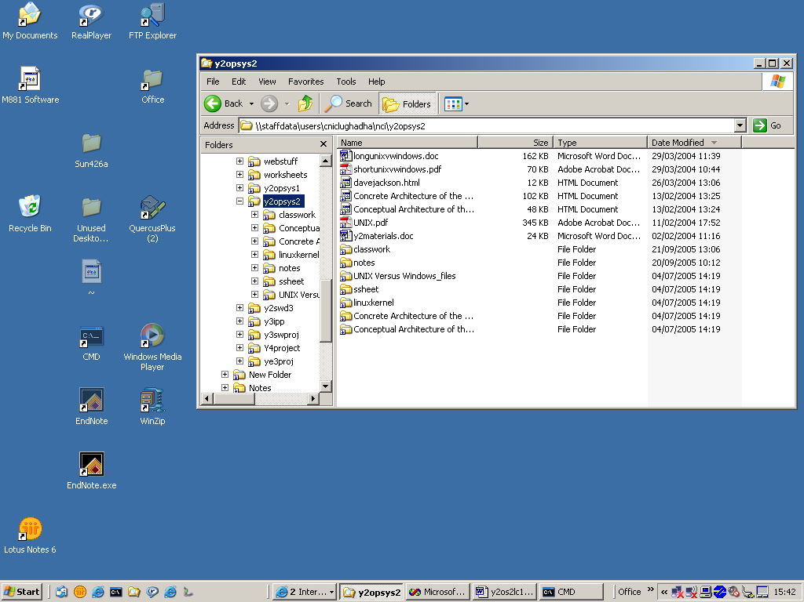
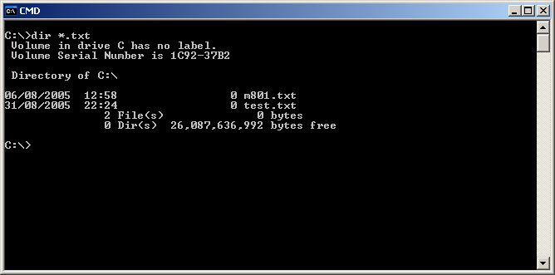
1.6 Windows NT - Introduction
Windows NT interface
Graphical User Interface (GUI)
Consists of icons, images, menu
Keyboard and mouse can be used
User friendly
Multi-tasking
multiple application can run in parallel
Command Line Interface (CLI)
A large number of commands can be executed, but sequential
Only skilled users can use this interface
May be faster than GUI to execute certain tasks
More info about Interface will be presented next week

Slide 26
1.7 Unix - Introduction
Unix heritage
1960’s: Initially designed as fun project (AT&T Bell Labs).
Thompson’s ‘Space Travel’ game - Kernighan & Ritchie,
UNIX OS written in B language is produced for the game and distributed to colleges & universities
1973: Unix is rewritten in ‘C’ language for speed and portability
Designed to be command line system
1984: Free Software Foundation created
It aims to reproduce all UNIX in a version free of licensing
1991: Linus Torvalds starts development of LINUX – a version of UNIX for the PC

Slide 27
1.7 Unix - Introduction
Unix like Operating Systems
Linux: Free, open software, various distributions (Red Hat, Ubuntu)
Solaris: Sun Microsystems
SCO UNIX and UNIXWARE: SCO -Santa Cruz Operation
System V Release 5: SCO ( Santa Cruz Operation)
HP_UX: Hewlett Packard
AIX: IBM
A/UX: Apple

Slide 28
1.7 Unix - Introduction
Unix main characteristics
Open source code
Source code is available to users and programmers to be modified if required
Fosters evolution, customisation, compatibility
Multi-tasking
More than one application can run at the same time
Multi-user
More than one user can login and use it
Portability
Most OSs are written in Assembler, specific for an architecture. VERY difficult to 'port' these OSs to other architectures.
UNIX is mostly written in the C language, allowing it to be portable to many architectures.
UNIX runs on more architectures than any other OS, (from that time)

Slide 29
1.7 Unix - Introduction
Unix main characteristics
Network Capabilities
Support internet connections.
Supports network applications to be run (e.g. web browsing application)
Various Software Availability
Tools and Utilities provided, are simple and powerful
Virtual Memory support
It can run programs that require bigger memory space than amount of RAM (main memory) the computer actually has!

Slide 30
1.8 Structure of an Operating System
Hardware
Each layer provides a set of functions dependent only on the services provided by the system layer within it
We will talk about each layer in the next lectures

Slide 31
Learning Outcome
After this lecture you should have an overall understanding of the purpose of an Operating System.
You should know the following:
The typical characteristics of an Operating System.
Operating System responsibilities
A bit of Operating System’s history
Brief introduction about Windows NT and Unix
History
Main characteristics

